Slide 1
Year 10 Work Experience The Gilberd School 10-14 March 2025 (X Population) 17-21 March 2025 (Y Population) Parent/Carer Information Evening

Slide 2
Three things!
Lots of information, so …
Own placement – to guarantee choice
Deadline not a target – don’t leave own placement until the last minute
Once any placement confirmed … contact employer!

Slide 3
What is Work Experience?
An unpaid opportunity for you to experience working life, whilst you are still at school
A chance for you to develop and practice new skills and become more confident in your abilities
A general experience of work, but can be vocational
May help you refocus on education and form future career choices

Slide 4
‘Own Placements’
Placements could be anywhere in the UK
Employers in some occupations prefer direct approach by students
Prepare how you dress and what you will say to the employer…..why do you want to work there?
Prepare an introductory email
Placements should not be with a direct family member
Check the journey route, times and the cost
Be realistic about what work you will do in that job role

Slide 5
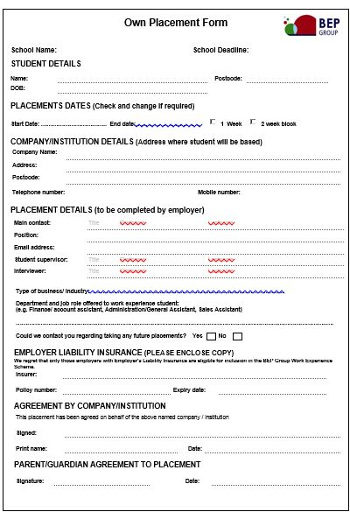
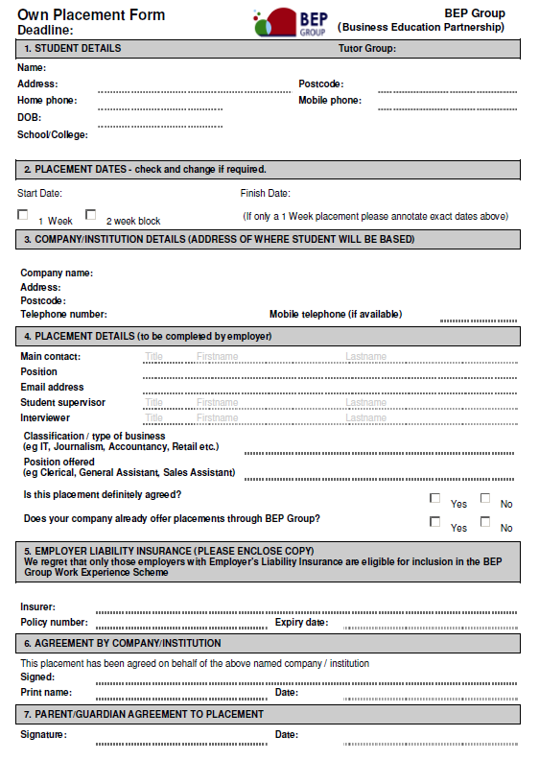
The employer must have Employer Liability Insurance (ELI)
All forms must be fully completed with all employer contact details
Must pass a pre-placement check carried out by an approved person
Forms must be signed and returned to the school 25 October 2024

Slide 6
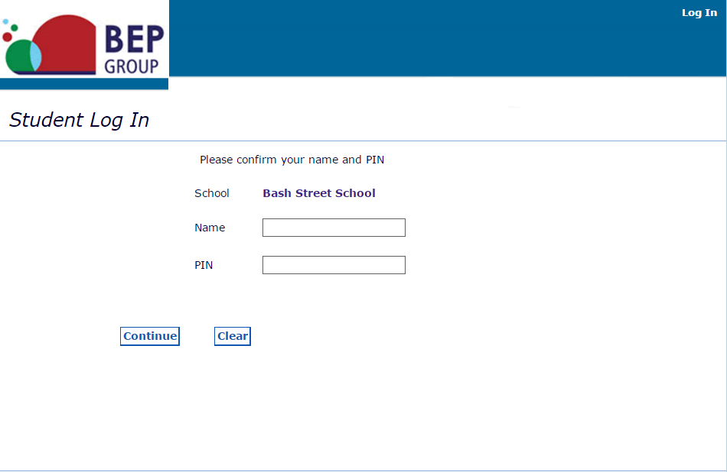
Webview (Online Work Experience System)
www.bepgroup.net
First and Last name
School will issue PIN

Slide 7
When you have successfully logged in you will be directed to the student home page where you will be able start the process of making selections
There is a student guide to the system available under the ‘work experience literature’ icon
Click on ‘search’ to start looking for a placement

Slide 8
Filter by job
category and
location

Slide 9
A list of ‘available’ jobs will appear
By clicking on ‘view’ you can see a full job description for the placement you are thinking of selecting
Most jobs available on the system will be in administration, retail and education

Slide 10
Parent/carer’s should also view the selections to check location, hours tasks and health and safety

Slide 11
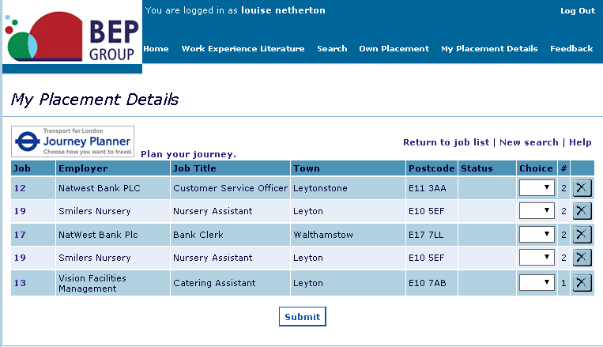
You will need to make a minimum of 3 and up to 6 ‘live job’ selections, put them in choice order and be prepared to go to any one of your choices.
Submit 17/01/25 – 21/02/25

Slide 12
After allocation
You may need to reselect, if not allocated a job
You will receive a job description which includes a risk assessment for the job and a parental consent form
This needs to be signed by the student and your parent, guardian or carer and returned to school
All students will be issued with a log book to record their work experience

Slide 13
Employer Contact
BEP informs the employer of the placement details…employers do sometimes forget!
On receipt of the parental consent form and job description, you must contact the employer immediately to confirm your attendance.
Some employers may have to withdraw from accepting the placement, this can be at a late stage
In many cases, no contact = no work experience!!!

Slide 14
During the Placement
You will be expected to work business hours. This is anything up to a maximum of 40 hours per week!
You must contact your employer if you are ill, running late or attending an appointment
BEP Group will be advised if you do not attend placement and in turn will contact the school to find out where you are
If you have any issues during your placement you must contact the school

Slide 15
Whilst on placement you will be treated as an employee by the company, you can be dismissed!
Phones
Attitude
Conduct
Timekeeping

Slide 16
After the Placement
On completion of Work Experience employers can leave feedback in your log book, have a look!
You may be asked to complete a school evaluation form to feedback about your placement
On successful completion of your placement, you will be issued with a certificate
Some successful placements can lead to employment or more!

Slide 17
www.bepgroup.net
Any questions?

